Slide 1
ROOM ASSIGNMENT PROBLEM
Yuguo Jiang
Guangfu Lyu
Jian Li

Slide 2
OUTLINE
Introduction​
Optimization Problem
​Smaller Excel Model
Analysis in Python
Business Application and Hypothetical Clients​
Limitation
Ideas for Analysis/Extensions

Slide 3
INTRODUCTION
Imagine you are an activity administrator, you are going to have a workshop in recent days. This workshop will contain five activities and there are 516 participants divided into 10 groups participating in the workshop. Each participant has indicated their first and second priority in advance. As the administrator, you want to satisfy as much priorities as possible to make everyone in your company happy. How will you make the arrangement?

Slide 4
OPTIMIZATION PROBLEM
Decision variables: Assign people “i_1” to room “i_2” to activity “j”
Objective: Maximize the number of people getting their 1st and 2nd preferences
Constraints:
(1)Participants are part of teams and should be assigned together
(2)Each activity lasts for half a day, and each participant will take part in one activity in the morning and one activity in the afternoon
(3)Each room must contain the same activity in the morning and in the afternoon
(4)Each room can only contain a certain number of people

Slide 5
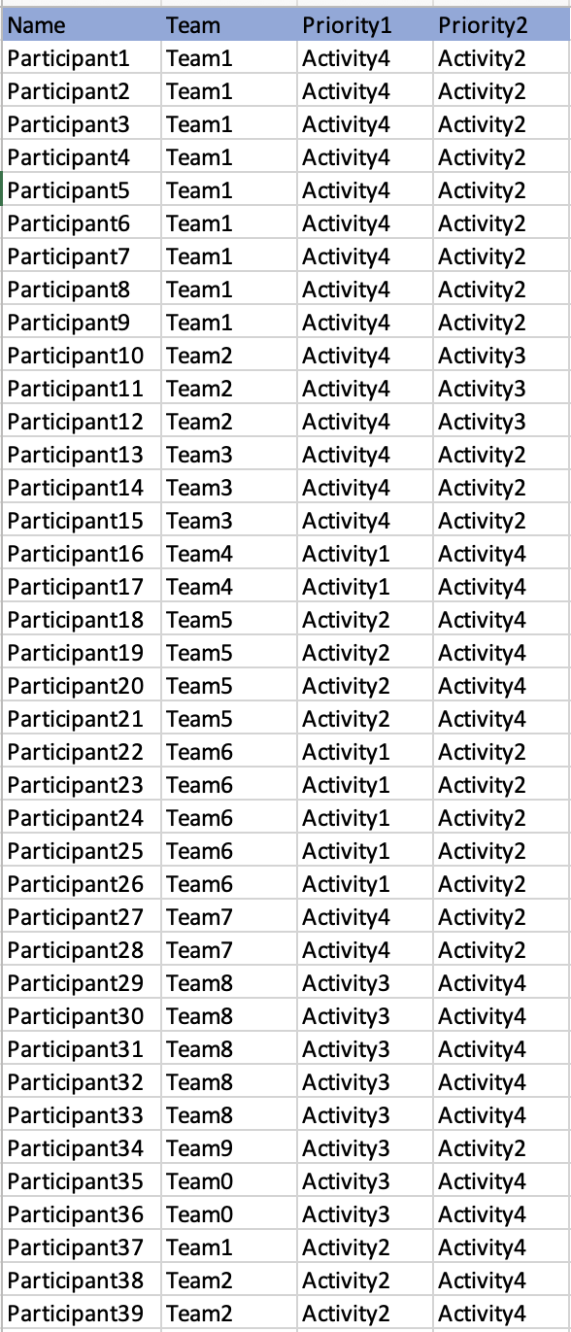
Input
Parameter data:
Data resource: Kaggle
We preprocessed the original data and filtered out the column related to the topic, which is the final presentation.
We have a spreadsheet contains the information for each participants. The number of participant, the team they belong to and their first and second choice for the activity.

Slide 6
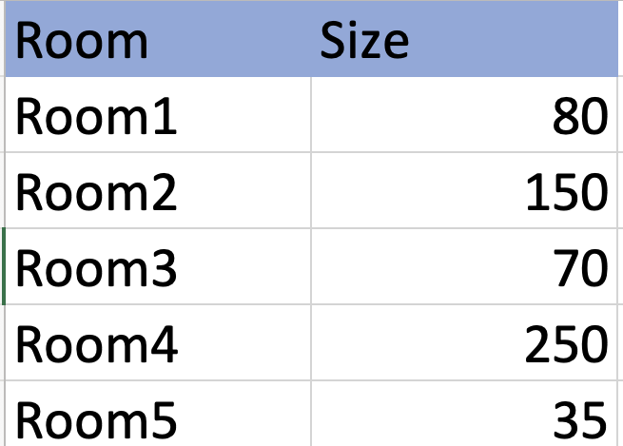
Input
Parameter data:
We also have a spreadsheet contains the information for each room and their size.

Slide 7
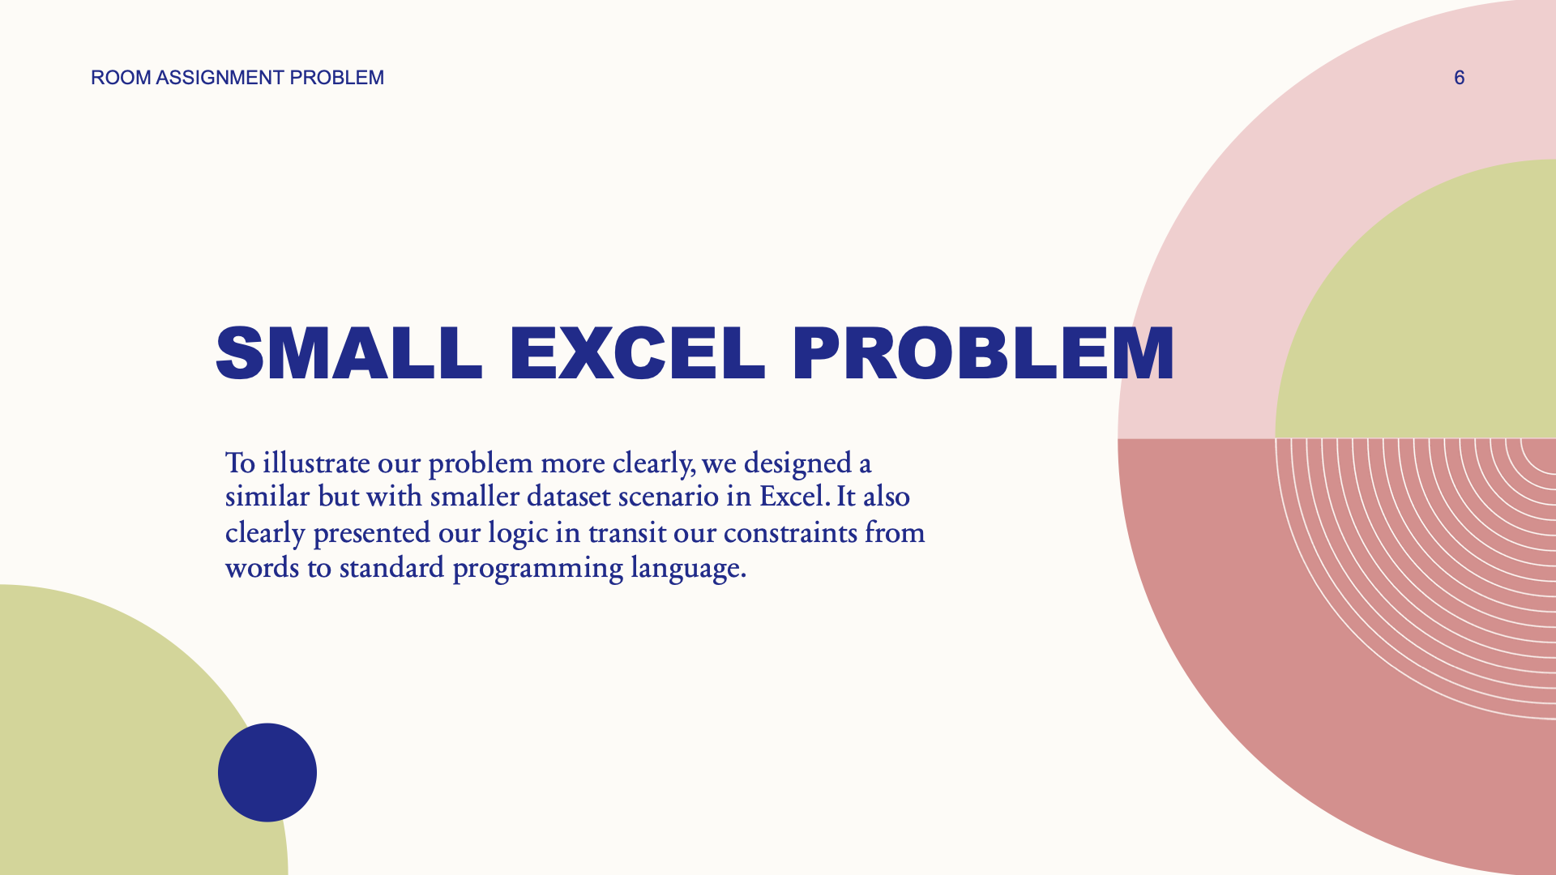
Smaller Excel Model

Slide 8
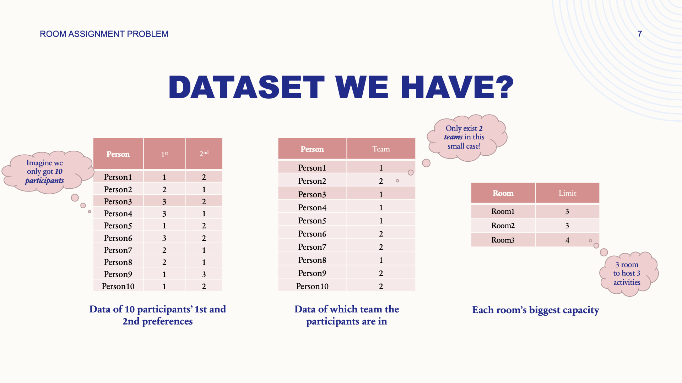

Slide 9
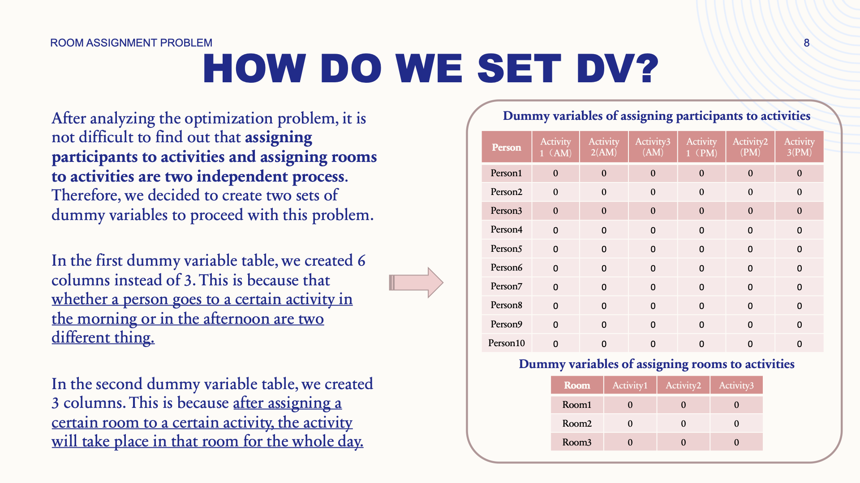

Slide 10
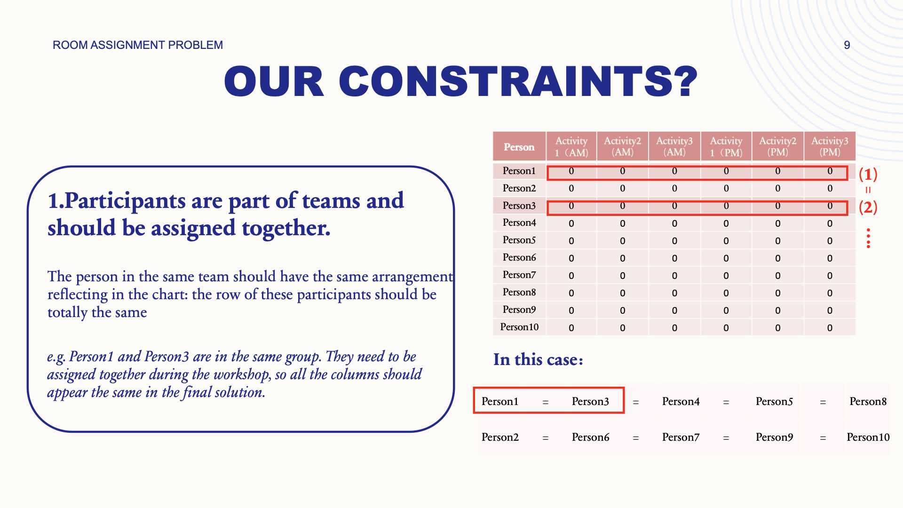

Slide 11
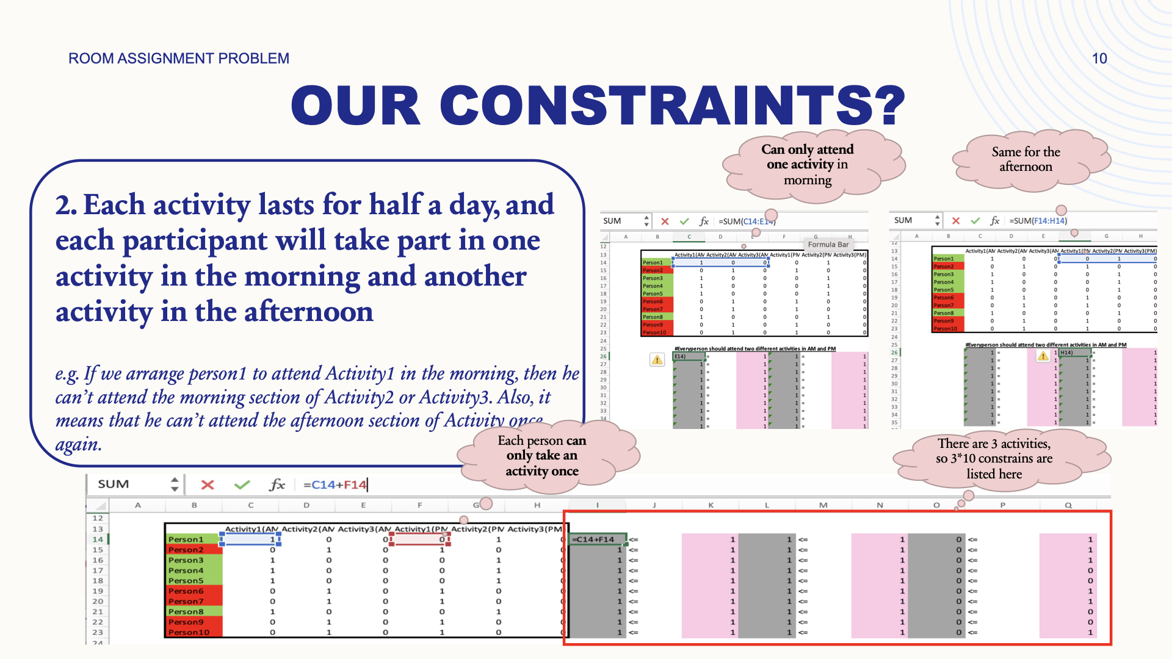

Slide 12
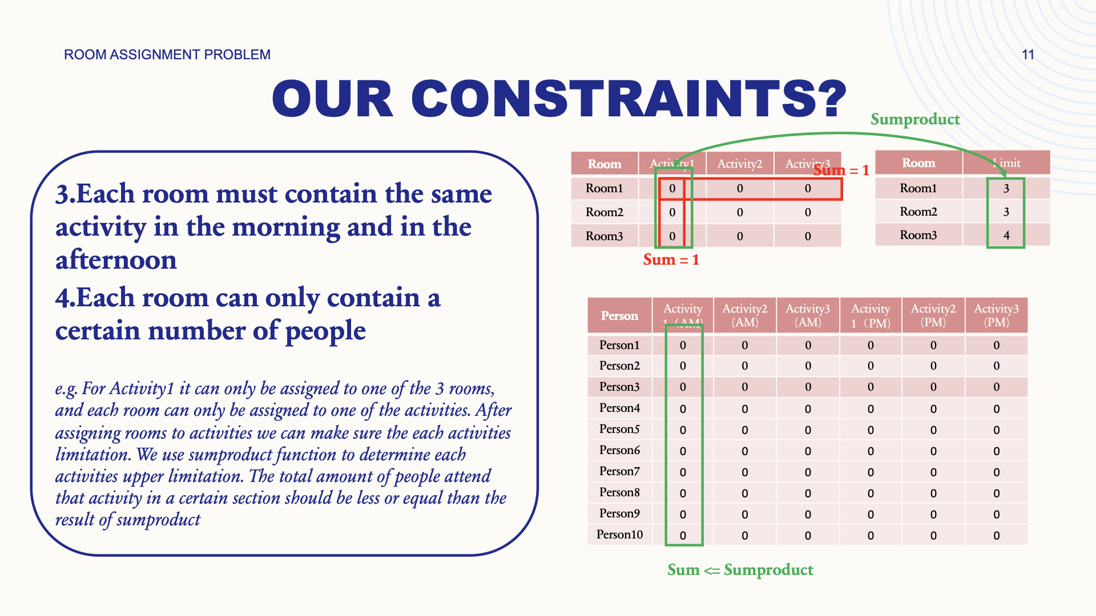

Slide 13
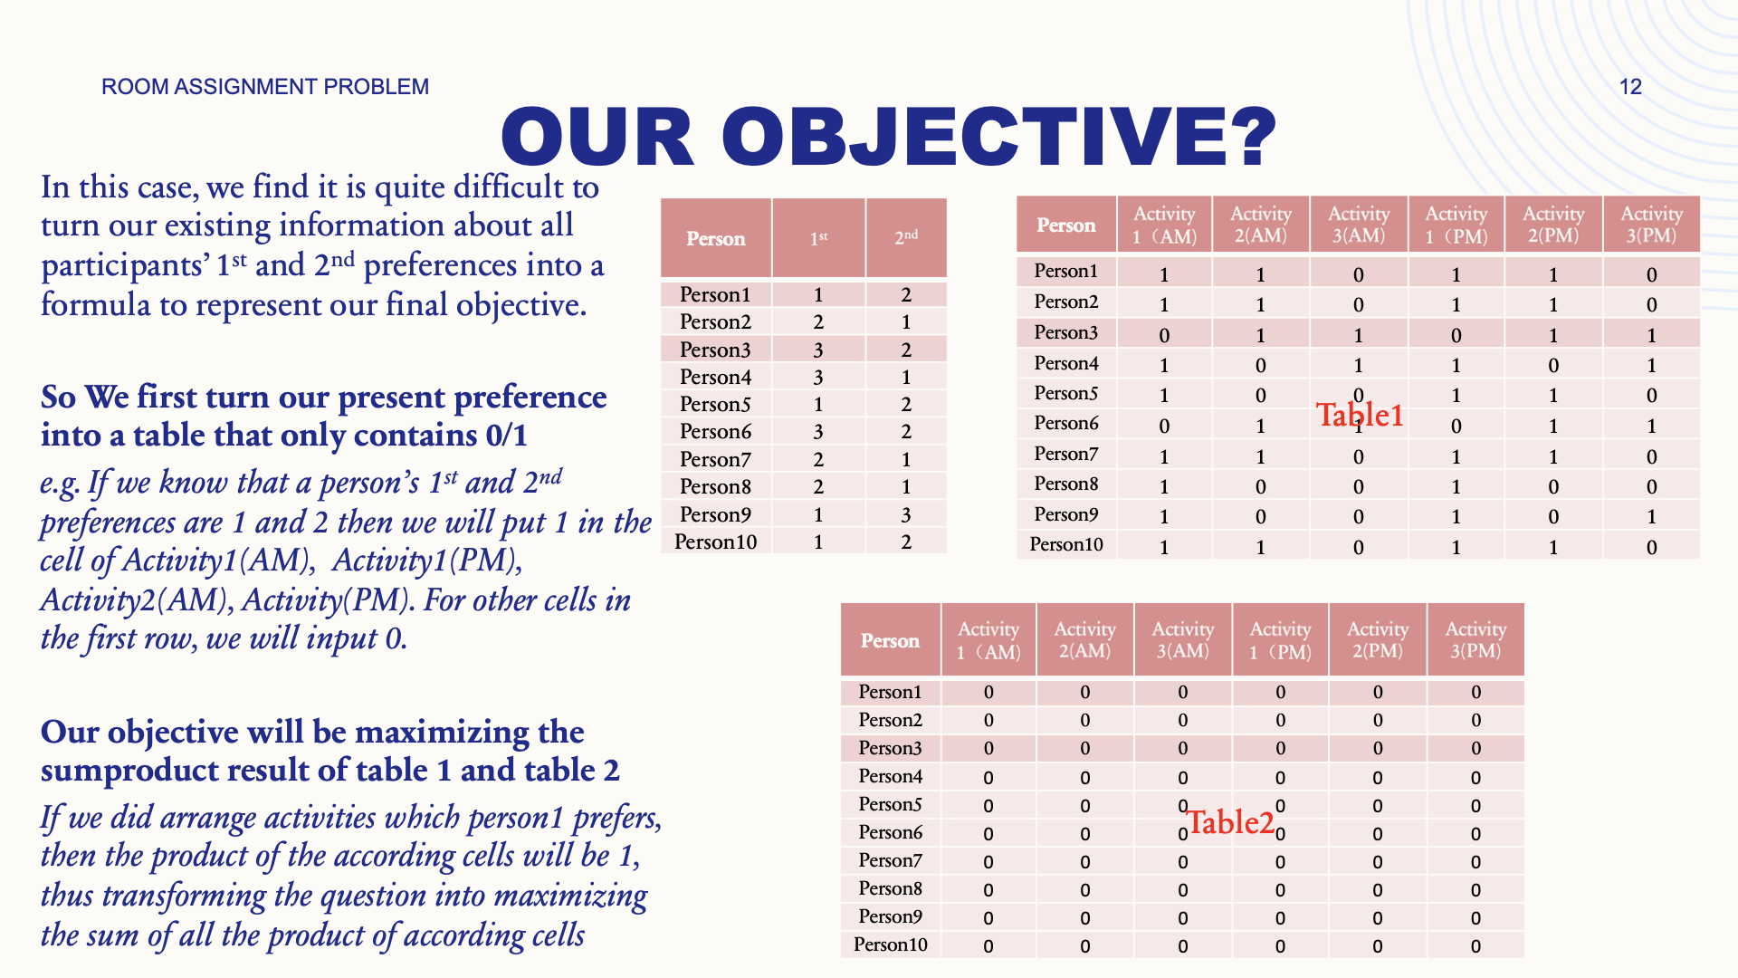

Slide 14
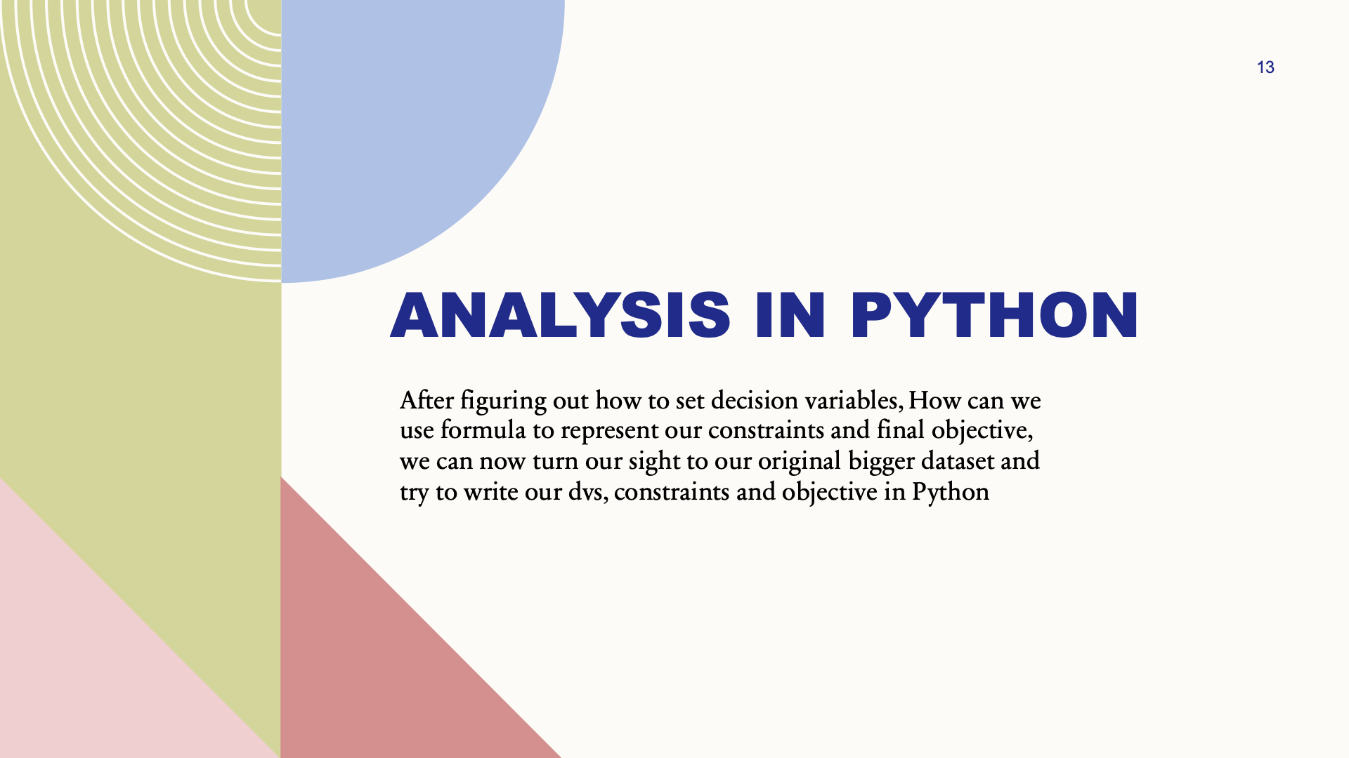
Analysis in Python

Slide 15
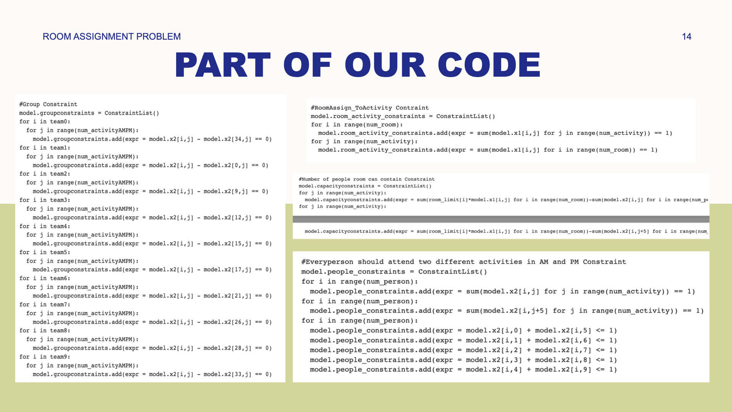

Slide 16
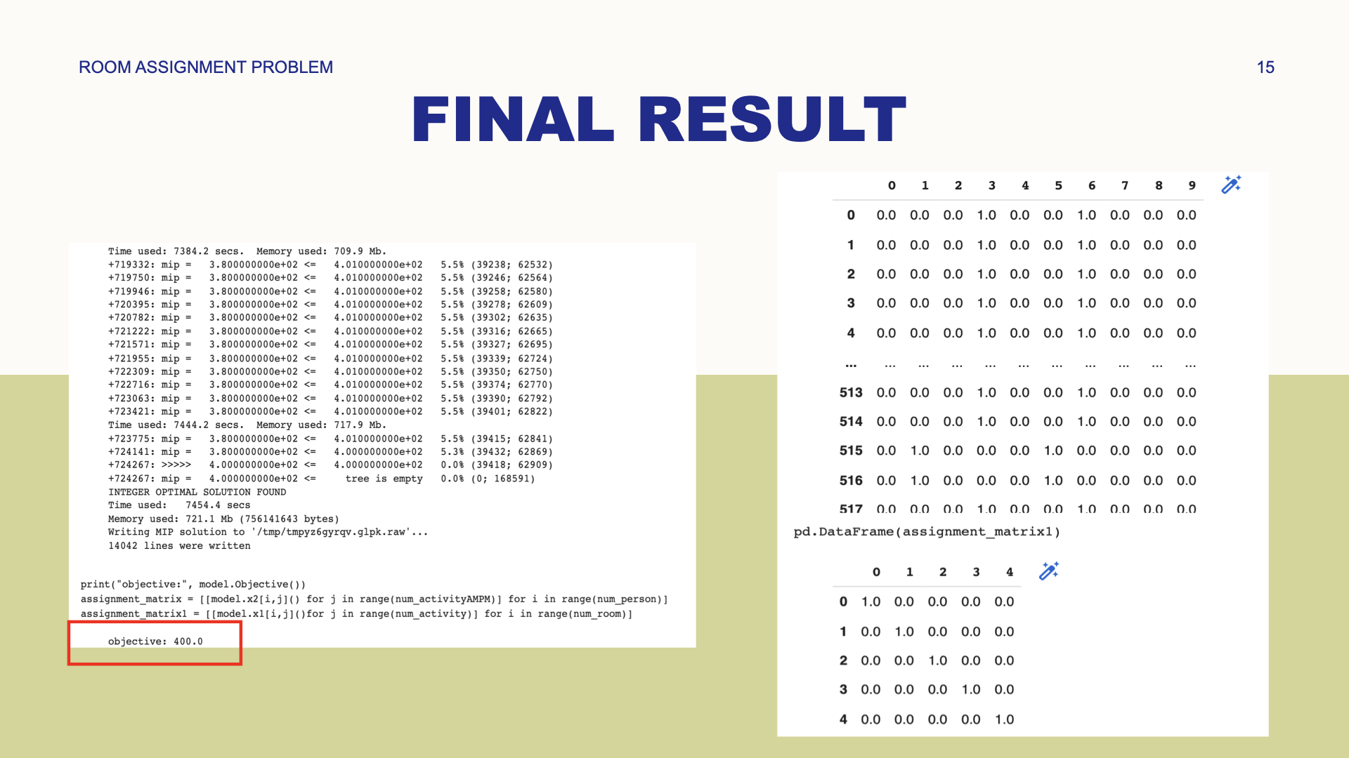
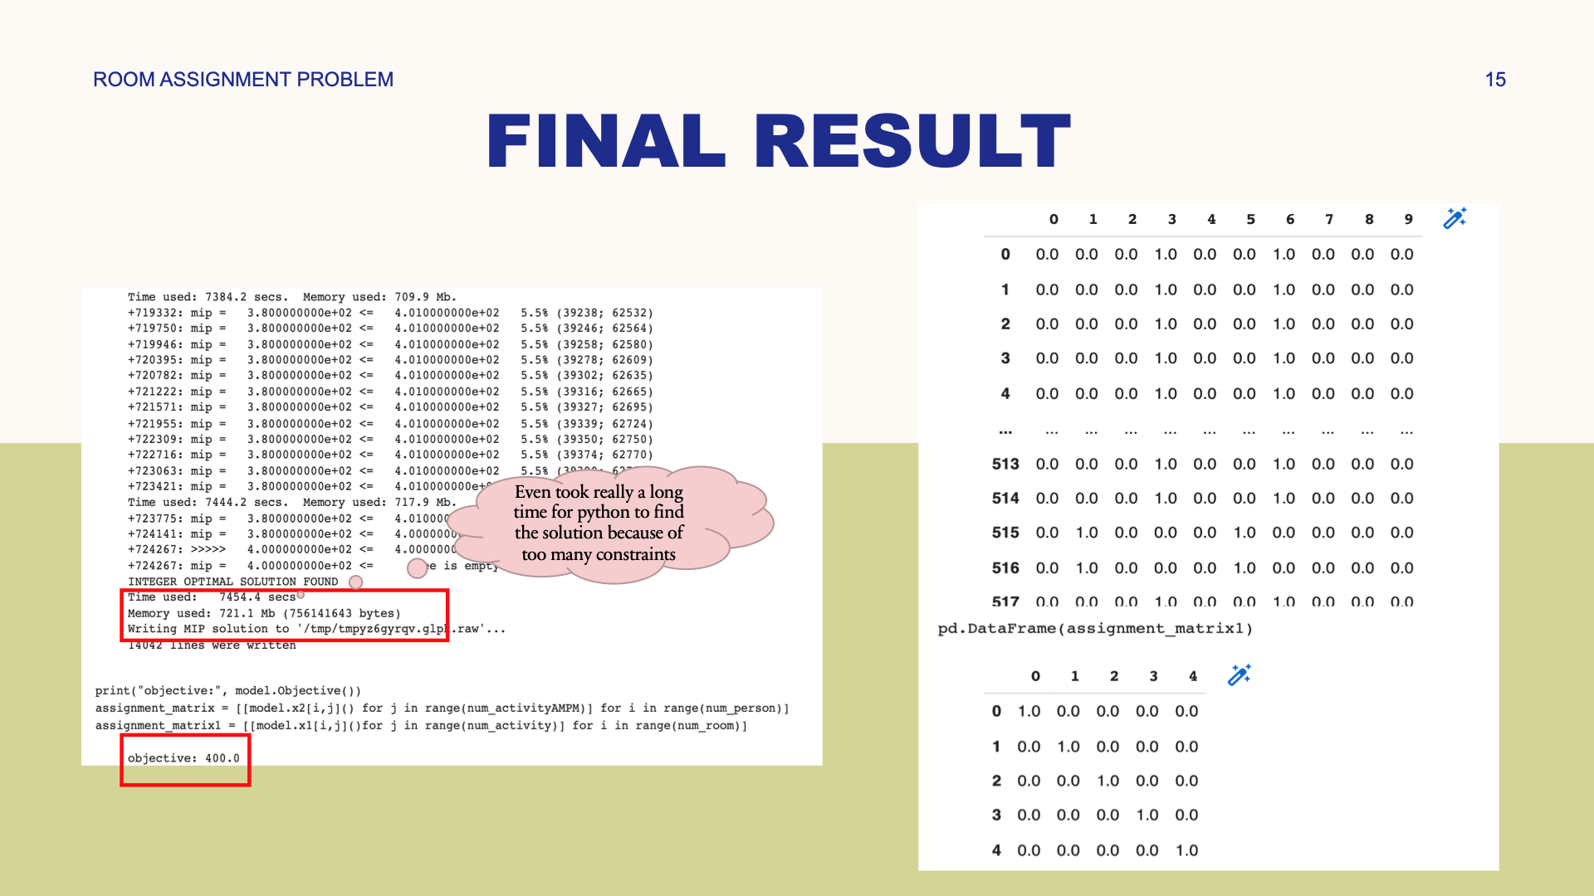

Slide 17
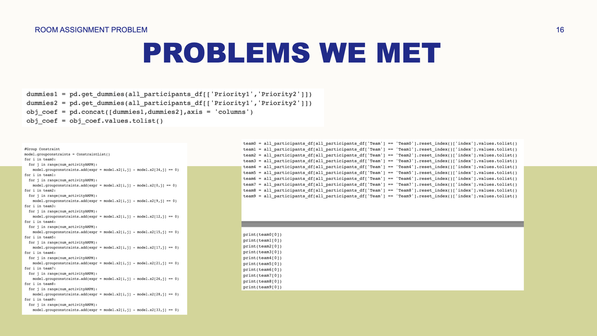
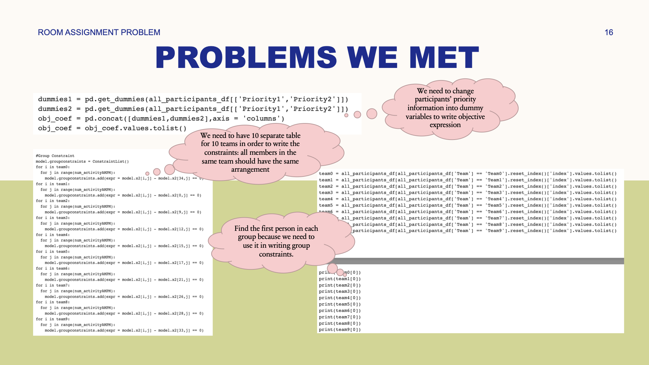

Slide 18
Business Application and Hypothetical Clients

Slide 19



Benefits to Hypothetical Clients
It can maximize the willingness of participants to participate in activities
It can lead to more equitable distribution way
Save time and reduces errors for the organizer

Slide 20
Hypothetical Client 1
Managers of companies who need to match employees to projects in different areas
DVs: Assign employee i to project j
Objective: Mostly meet the priorities of all the employees
Constraints:
(1) Every project must be assigned at least one lawyer, one CPA, and one Industry researcher
(2) Keep the travel expense under XXX dollars
(3) Employees are from different areas so the travel expense to different projects varies
Application: Add a plug-in on the office software of the company. The employees update their own priorities every year and the managers get the data and optimize it using the function on the office software.

Slide 21
Hypothetical Client 2
Managers of airline companies who need to assign stewardesses and pilots to airplanes and airlines
DVs: Assign people i to airplane j and airline k
Objective: Mostly meet the priorities of all the staff
Constraints:
(1) Different airlines have different requirements for airplanes and staff
(2) Each airline gets assigned to at least X stewardesses and at most Y stewardesses
(3) Each airline gets assigned to at least X pilots and at most Y pilots
Application: Make an application on phone for the employees of the airline company. Everyone should use the app to select their prior airlines and the manager will decide on it using the optimization model.

Slide 22
Hypothetical Client 3
Directors of programs who want to assign 100 students to 10 practicum projects
DVs: Assign student i to project j
Objective: Mostly meet the priorities of all the students
Constraints:
(1) Each project gets assigned to at least 6 students and at most 13 students
Application: Let the students do surveys about their priorities and the directors do optimizations with our website.

Slide 23
Other Hypothetical Clients
All kinds of scheduling problem considering priority issues：
E.g., (1) The problem of selecting electives based on priorities
(2) Assign sites to student associations to display their achievements during the student club culture week
(3) Match different teachers to different examination rooms during the final exam week

Slide 24
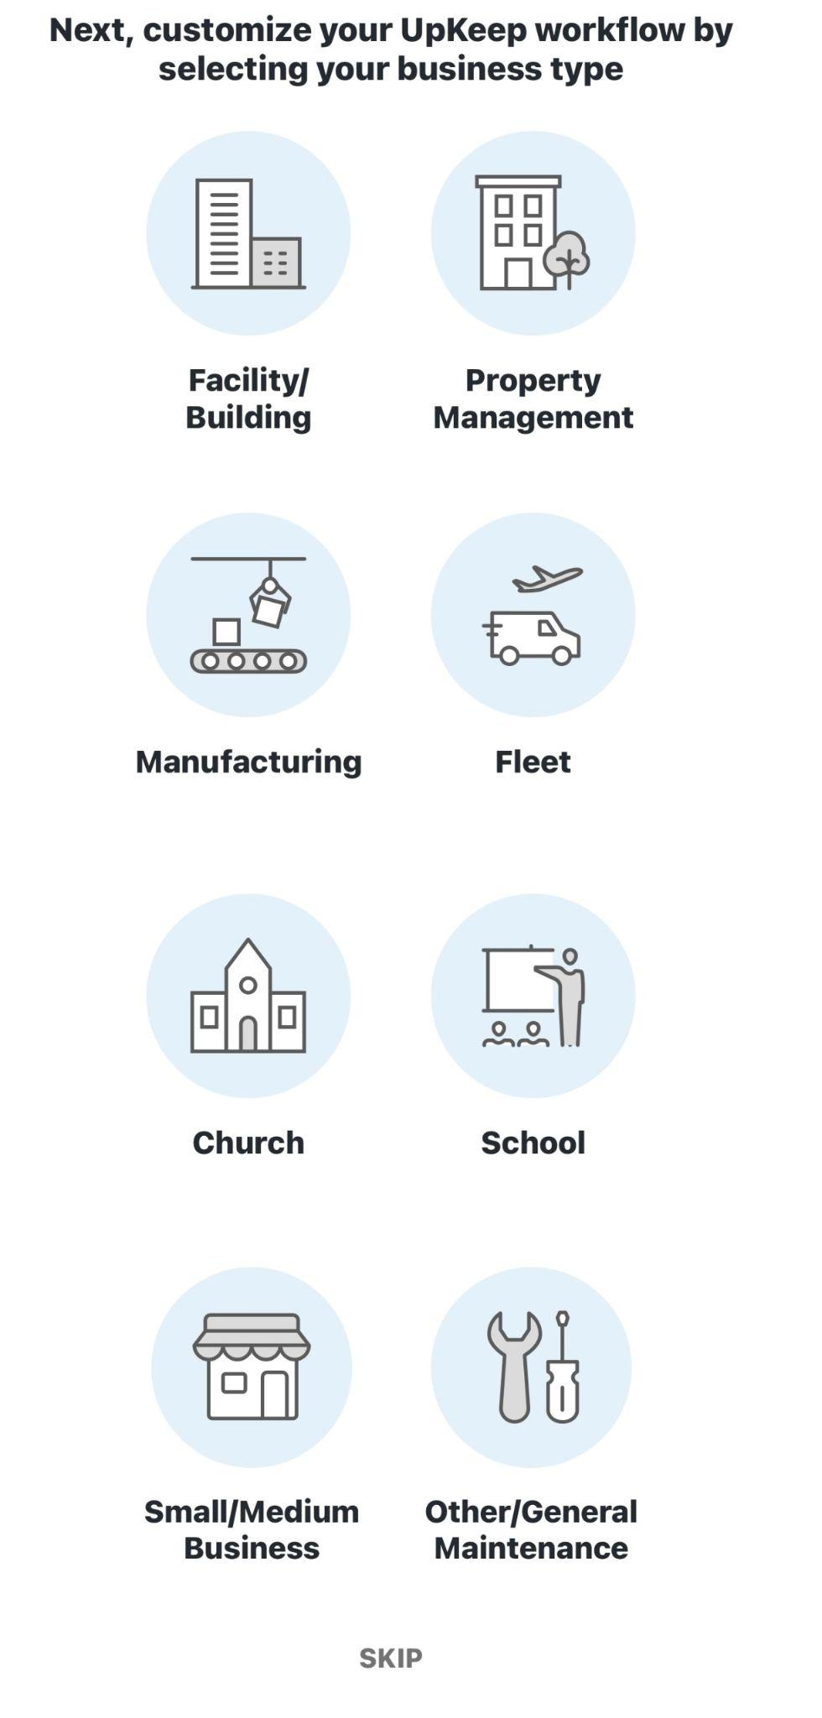
This is probably what the customer will see when they use it.
The clients can select the actual application scenario, then set the constraints as needed and generate the results automatically.

Slide 25
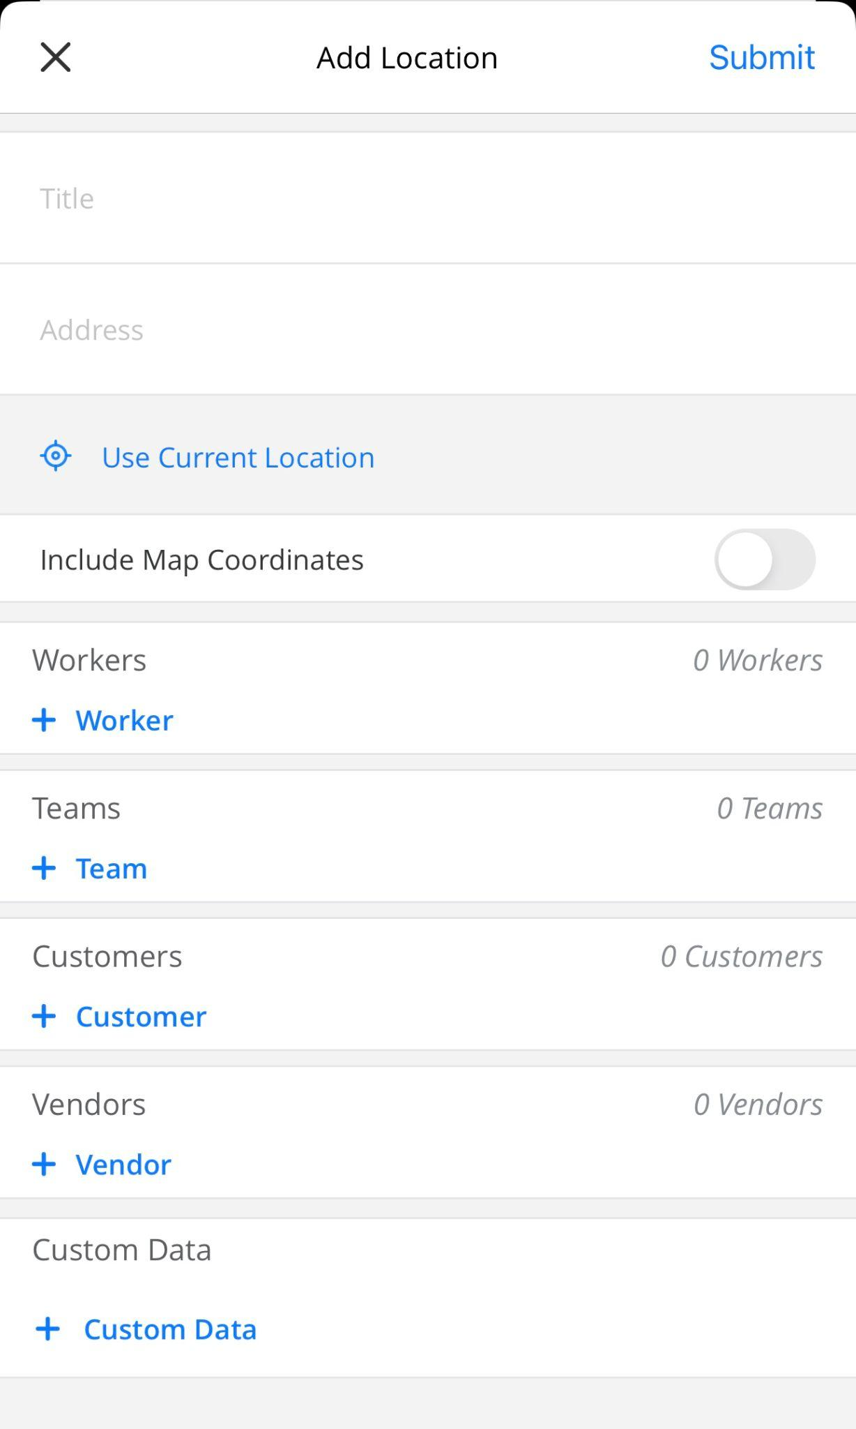
This is a screenshot of a specific scene.
The users can set locations, workers, teams, customers, vendors and custom data.
After submission, the system will automatically optimize the best results

Slide 26
The limitation of the project
The project we work on have many constraints, and there are probably not many real-life scenarios where such complexity can be applied.
It took a long time for Python to find a feasible solution because of too constraints.
How to overcome our limitation?

Slide 27
Ideas for Analysis/Extensions
Custom version
Constraints and sample size can both be custom depending on the clients’ requirements
Room assignment version
1. More constraints
2. Big sample size
General version
1. Less constraints
2. Small or big sample size

Slide 28
THANK YOU

